Slide 1
Internet Protocol

Slide 2
It is the major protocol of Internet Layer.
It is a connectionless communication protocol of the Internet Layer.
It is an unreliable protocol – because does not guarantee delivery of information.
It is a best effort delivery protocol.
It support error checking & discarding
Does not support acknowledgements/handshaking
Does not support retransmission
Acks/handshaking & retransmission are responsibility of high level protocols such as TCP,etc.

Slide 3
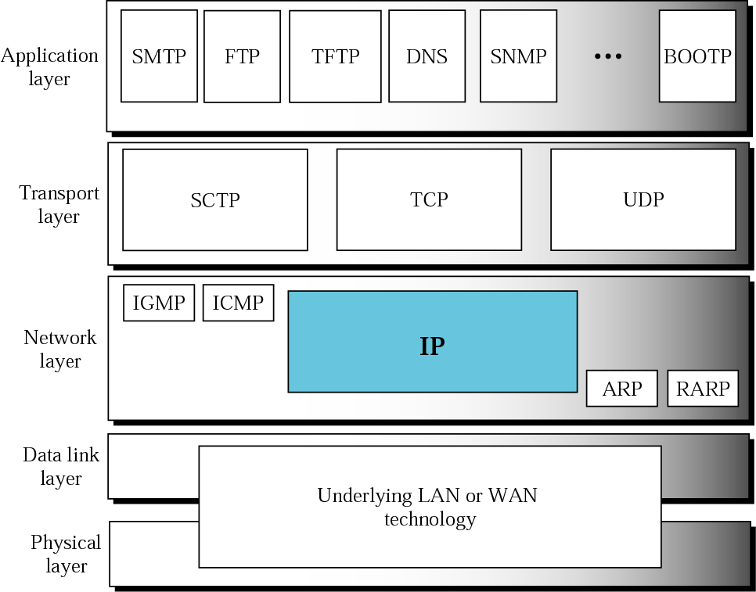
Figure Position of IP in TCP/IP protocol suite

Slide 4
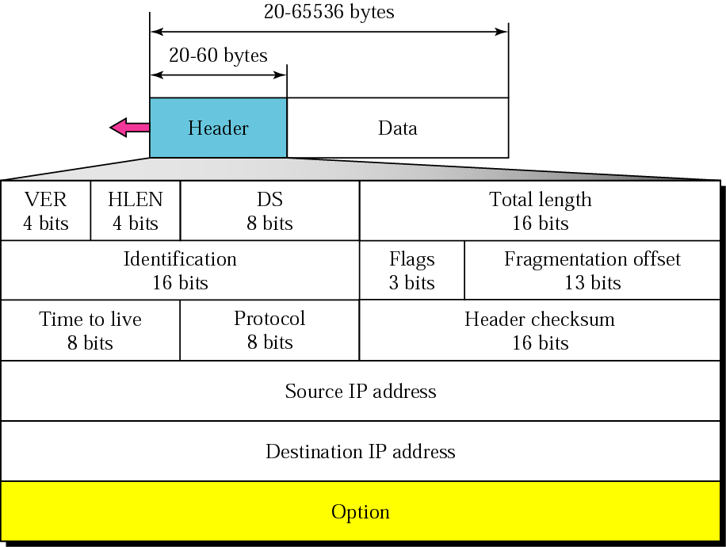
Figure IP datagram/Packet

Slide 5
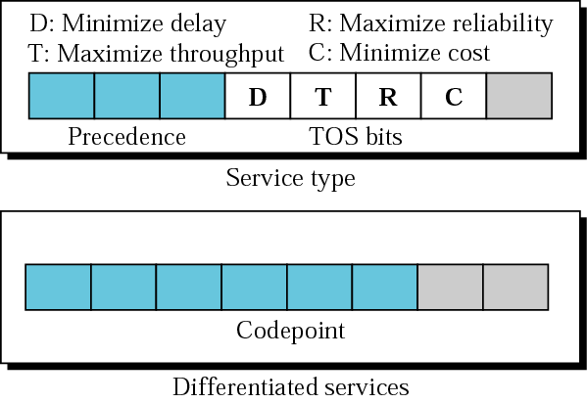
Figure 8.3 Service type or differentiated services

Slide 6
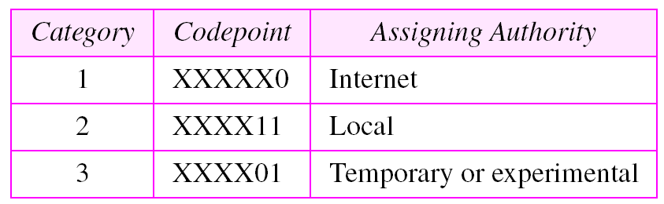
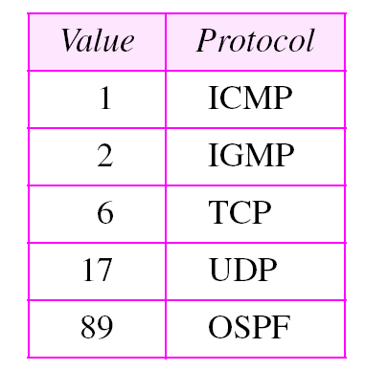
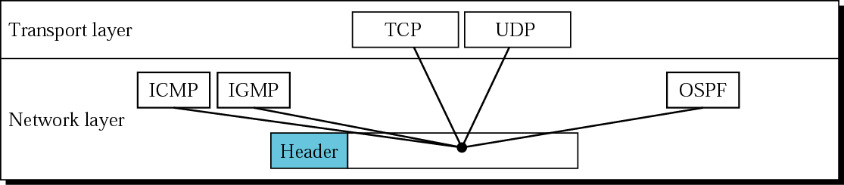
Table Values for codepoints
Figure Multiplexing

Slide 7
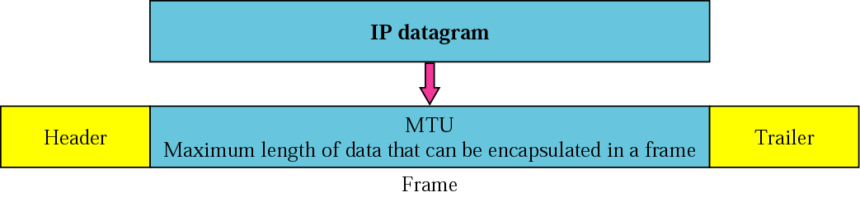
FRAGMENTATION
The format and size of a frame depend on the protocol used by the physical network. A datagram may have to be fragmented to fit the protocol regulations.

Slide 8
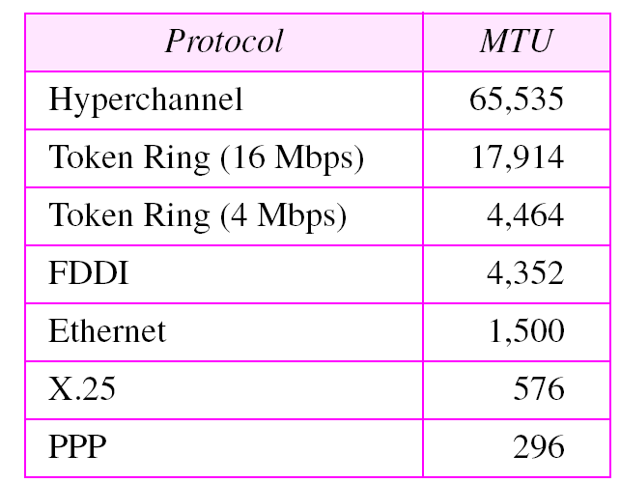
Table MTUs for some networks

Slide 9
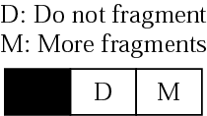
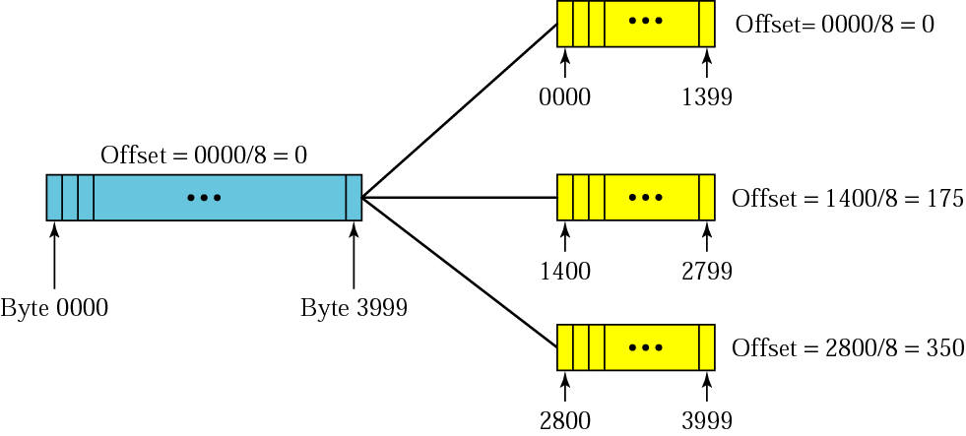
Figure Flags field
Figure Fragmentation example

Slide 10
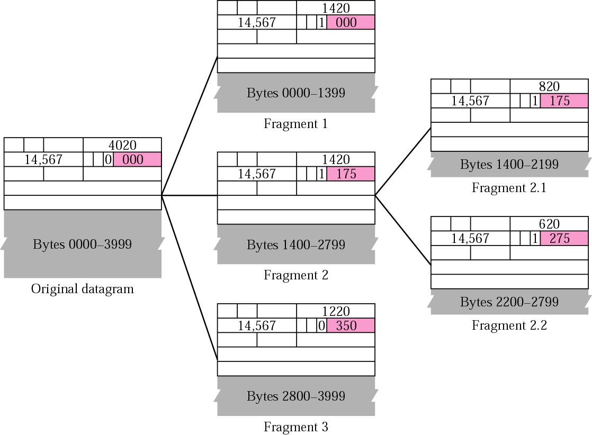
Figure Detailed fragmentation example

Slide 11
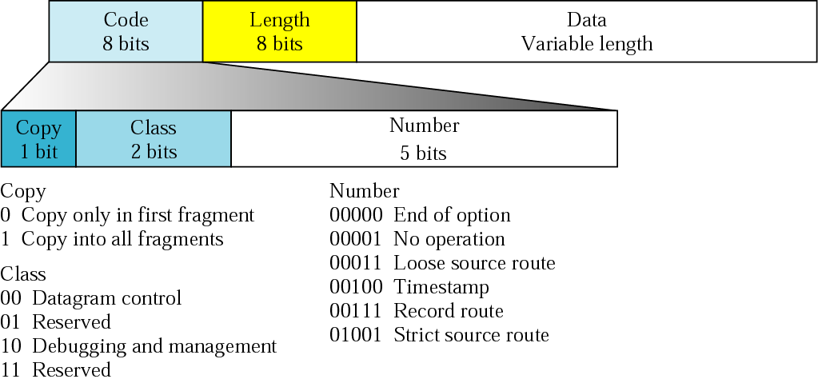
OPTIONS
The header of the IP datagram is made of two parts: a fixed part and a variable part. The variable part comprises the options that can be a maximum of 40 bytes.
Figure Option format

Slide 12
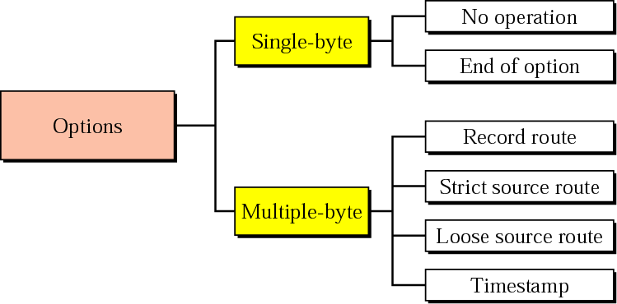
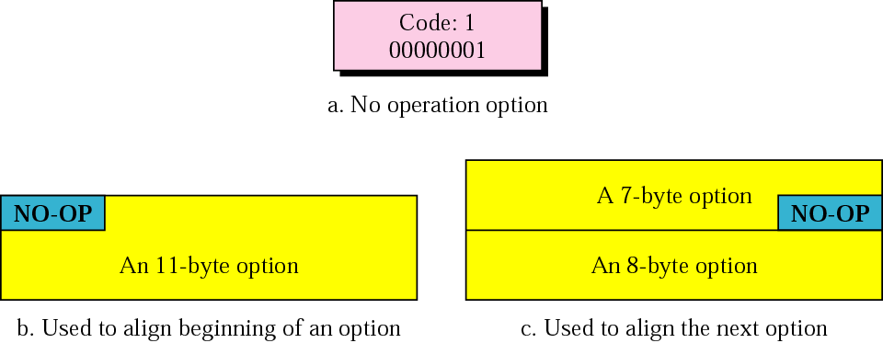
Figure Categories of options
Figure No operation option

Slide 13
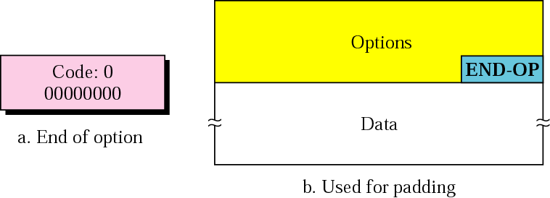
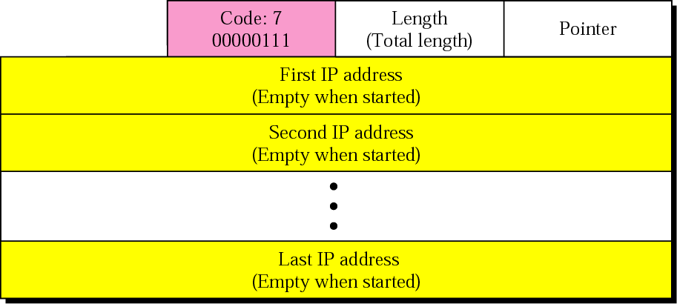
Figure End of option option
Figure Record route option

Slide 14
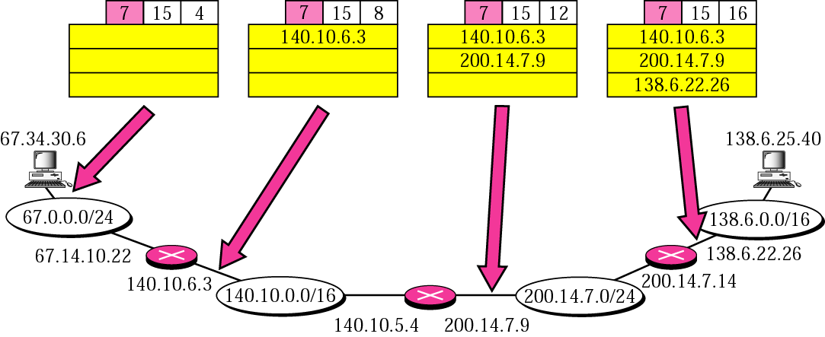
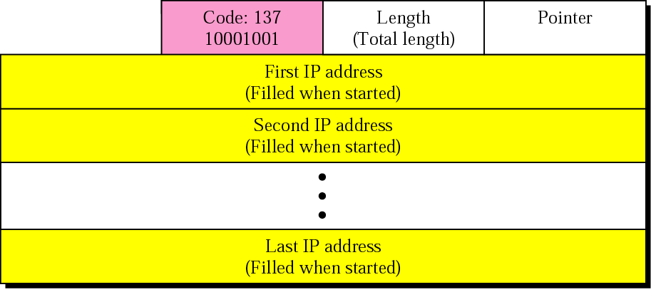
Figure Record route concept
Figure Strict source route option

Slide 15
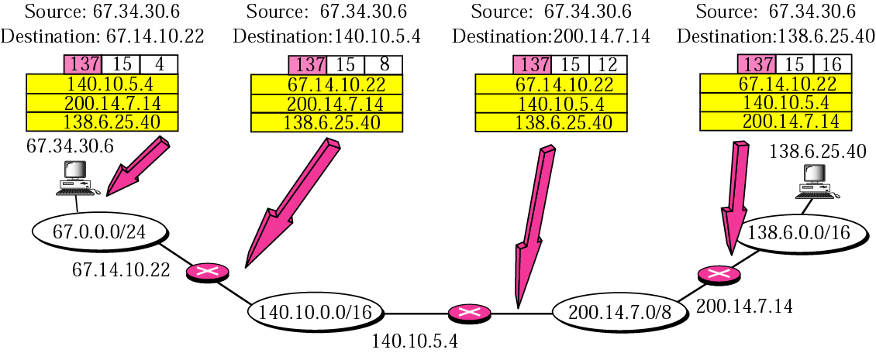
Figure Strict source route concept

Slide 16
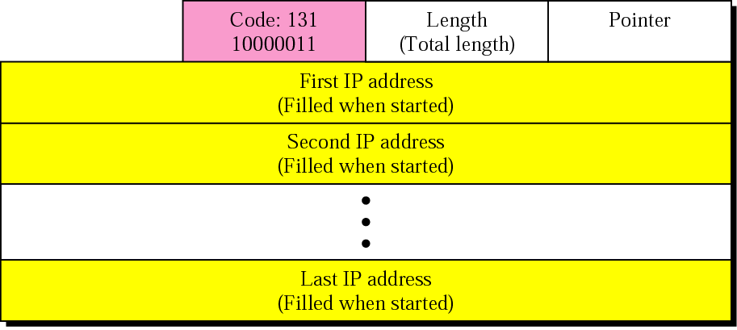
Figure Loose source route option

Slide 17
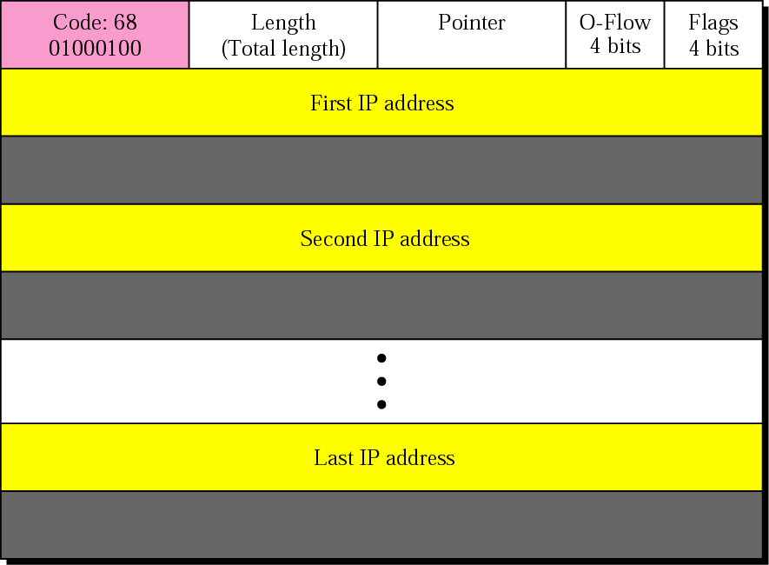
Figure Timestamp option

Slide 18
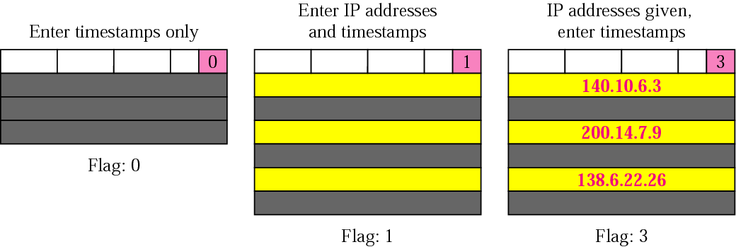
Figure Use of flag in timestamp

Slide 19
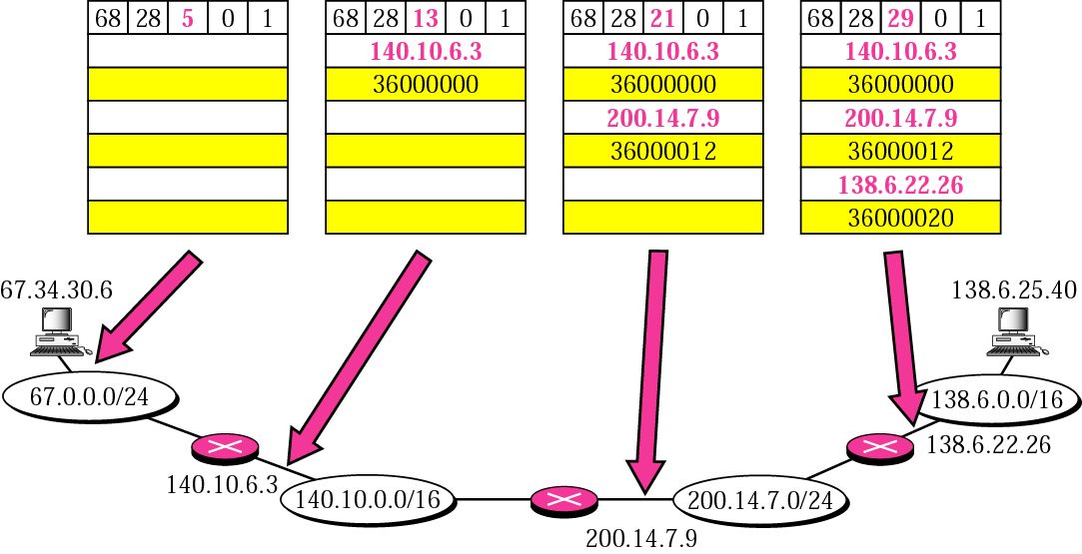
Figure Timestamp concept

Slide 20
Example 10
Which of the six options must be copied to each fragment?
Solution
We look at the first (left-most) bit of the code for each option.
a. No operation: Code is 00000001; not copied.
b. End of option: Code is 00000000; not copied.
c. Record route: Code is 00000111; not copied.
d. Strict source route: Code is 10001001; copied.
e. Loose source route: Code is 10000011; copied.
f. Timestamp: Code is 01000100; not copied.

Slide 21
Example
Which of the six options are used for datagram control and which are used for debugging and management?
Solution
We look at the second and third (left-most) bits of the code.
a. No operation: Code is 00000001; datagram control.
b. End of option: Code is 00000000; datagram control.
c. Record route: Code is 00000111; datagram control.
d. Strict source route: Code is 10001001; datagram control.
e. Loose source route: Code is 10000011; datagram control.
f. Time stamp: Code is 01000100; debugging and management
control.

Slide 22
8.4 CHECKSUM
The error detection method used by most TCP/IP protocols is called the checksum. The checksum protects against the corruption that may occur during the transmission of a packet. It is redundant information added to the packet.
To create the checksum the sender does the following:
❏ The packet is divided into k sections, each of n bits.
❏ All sections are added together using 1’s complement
arithmetic.
❏ The final result is complemented to make the
checksum.

Slide 23
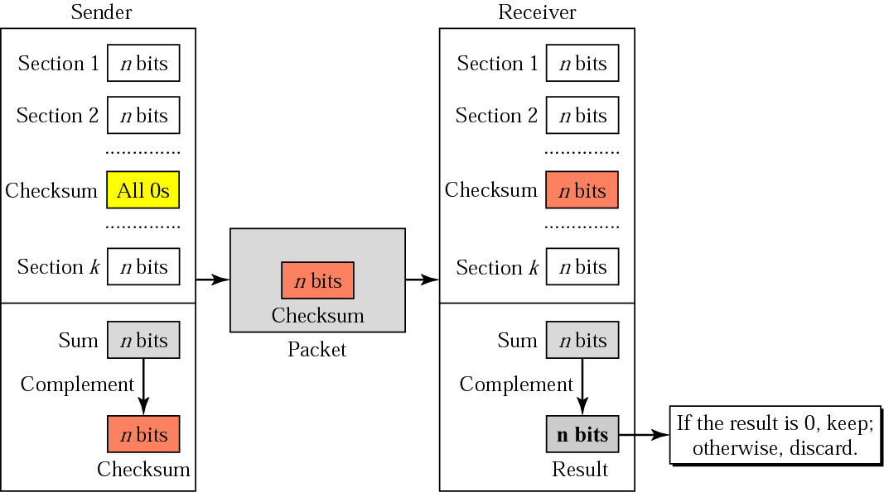
Figure Checksum concept

Slide 24
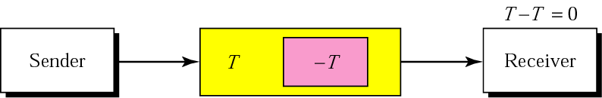
Figure Checksum in one’s complement arithmetic

Slide 25
8.5 IP PACKAGE
IP software package components and the relationships between the components. This IP package involves eight modules.
Header-Adding Module
Processing Module
Queues
Routing Table
Forwarding Module
MTU Table
Fragmentation Module
Reassembly Table
Reassembly Module

Slide 26
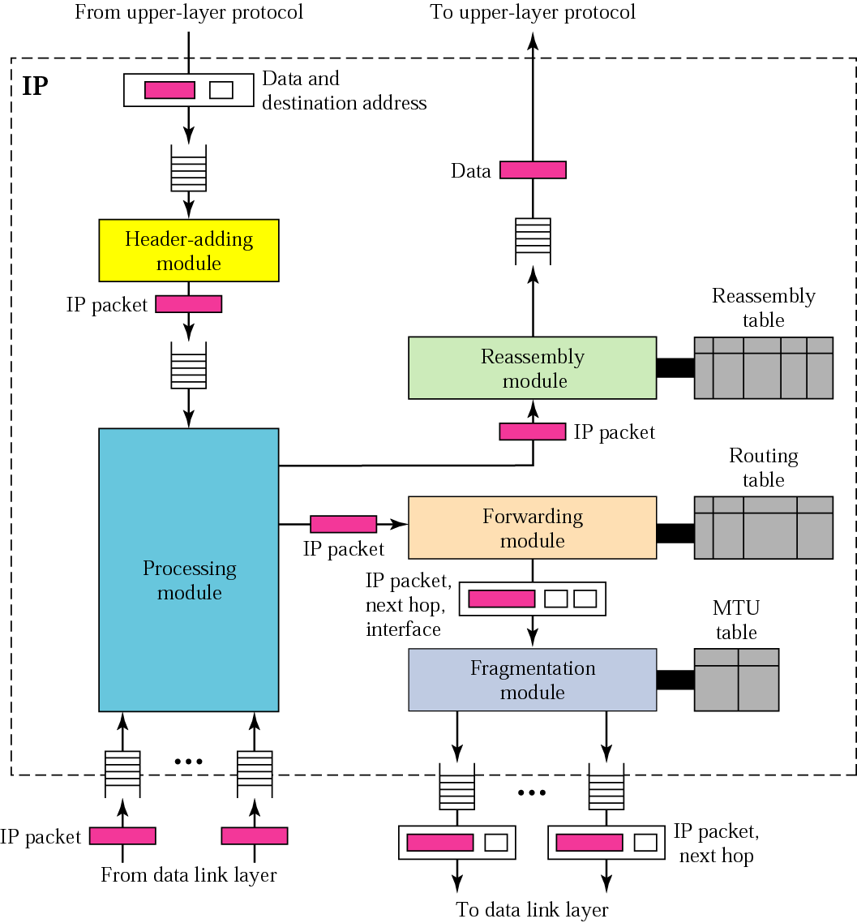
Figure IP components

